Slide 1
Python 教學
Lorin Yeh

Slide 2
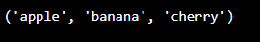
Python Data Types
tuple
Tuple items are ordered, unchangeable, and allow duplicate values.
Tuple items are indexed, the first item has index [0], the second item has index [1]
myTuple = ("apple", "banana", "cherry“)
print(myList)

Slide 3
Python Data Types
tuple
tuple length
Only one item tuple
thistuple = ("apple", "banana", "cherry") print(len(thistuple))
thistuple = ("apple", )

Slide 4
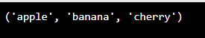
Python Data Types
tuple
A tuple can contain different data type
Tuple Constructor
tuple1 = ("abc", 34, True, 40, "male")
thistuple = tuple(("apple", "banana", "cherry"))

Slide 5
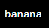
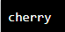
Python Data Types
tuple
Access tuple
thistuple = ("apple", "banana", "cherry") print(thistuple[1])
thistuple = ("apple", "banana", "cherry") print(thistuple[-1])

Slide 6
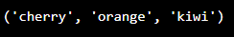
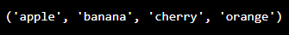
Python Data Types
tuple
Access tuple
thistuple = ("apple", "banana", "cherry", "orange", "kiwi", "melon", "mango") print(thistuple[2:5])
thistuple = ("apple", "banana", "cherry", "orange", "kiwi", "melon", "mango") print(thistuple[:4])

Slide 7
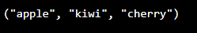
Python Data Types
tuple
Change Tuple Values, indirectly
x = ("apple", "banana", "cherry") y = list(x) y[1] = "kiwi" x = tuple(y) print(x)

Slide 8
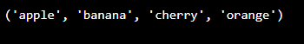
Python Data Types
tuple
Change Tuple Values, indirectly
thistuple = ("apple", "banana", "cherry") y = ("orange",) thistuple += y print(thistuple)

Slide 9
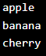
Python Data Types
tuple
Unpacking a tuple
fruits = (“apple”, “banana”, “cherry”) (green, yellow, red) = fruits #green, yellow and red are variables print(green) print(yellow) print(red)

Slide 10
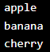
Python Data Types
tuple
Loop Through a Tuple
thistuple = ("apple", "banana", "cherry") for x in thistuple: print(x)

Slide 11
Python Data Types
tuple
Loop Through a Tuple
thistuple = ("apple", "banana", "cherry") for i in range(len(thistuple)): print(thistuple[i])

Slide 12
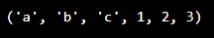
Python Data Types
tuple
Join tuples
tuple1 = ("a", "b" , "c") tuple2 = (1, 2, 3) tuple3 = tuple1 + tuple2 print(tuple3)

Slide 13
Python Data Types
Tuple in ACTS 3.0
Console.CI_Cmd_Scan(cmd, time_out, [(label, value), ....., (label, value)])
Send CI commands to the device/workstation shell and check the response
which contains (label, value) pairs or not
PASS: The response conatin all (label, value) pairs
FAIL: At least one (label, value) pair is not contained in the command response.
Arguments:
cmd: console/shell command
time_out: time_out value to wait the prompt
[(label, value), ....., (label, value)]
For example:
CI_Cmd_Scan("route -n", 10, [("172.202.77.0", "255.255.255.0")])

Slide 14
Python Data Types
Dictionary
Dictionaries are used to store data values in key:value pairs
A dictionary is a collection which is ordered, changeable and do not allow duplicates
thisdict = { "brand": "Ford", "model": "Mustang", "year": 1964 } print(thisdict)

Slide 15
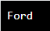
Python Data Types
Dictionary
Dictionaries are changeable, meaning that we can change, add or remove items after the dictionary has been created
thisdict = { "brand": "Ford", "model": "Mustang", "year": 1964 } print(thisdict["brand"])

Slide 16
Python Data Types
Dictionary
Duplicates Not Allowed
Duplicate values will overwrite existing values:
thisdict = { "brand": "Ford", "model": "Mustang", "year": 1964, "year": 2020 } print(thisdict)

Slide 17
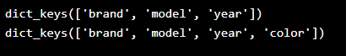
Python Data Types
Dictionary
car = { "brand": "Ford", "model": "Mustang", "year": 1964} x = car.keys()
print(x) #before the change car["color"] = "white“ # Add an item print(x) #after the change

Slide 18
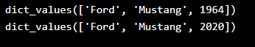
Python Data Types
Dictionary
car = { "brand": "Ford", "model": "Mustang", "year": 1964} x = car.values()
print(x) #before the change car[“year"] = 2020 # Change the value print(x) #after the change

Slide 19
Python Data Types
Dictionary
car = { "brand": "Ford", "model": "Mustang", "year": 1964} x = car.items()
print(x) #before the change car[“year"] = 2020
print(x) #after the change

Slide 20
Python Data Types
Dictionary
Check if key exists
thisdict = { "brand": "Ford", "model": "Mustang", "year": 1964, }
if "model" in thisdict: print("Yes, 'model' is one of the keys in the thisdict dictionary")

Slide 21
Python Data Types
Dictionary
Change item
thisdict = { "brand": "Ford", "model": "Mustang", "year": 1964, }
thisdict["year"] = 2018
print(thisdict)

Slide 22
Python Data Types
Dictionary
Add item
thisdict = { "brand": "Ford", "model": "Mustang", "year": 1964, }
thisdict.update({"color": "red"})
print(thisdict)

Slide 23
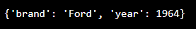
Python Data Types
Dictionary
Remove item
thisdict = { "brand": "Ford", "model": "Mustang", "year": 1964, }
thisdict.pop("model")
print(thisdict)

Slide 24
Python JSON
JavaScript Object Notation
{
"first_name": "John",
"last_name": "Smith",
"is_alive": true,
"age": 27,
"address": {
"street_address": "21 2nd Street",
"city": "New York",
"state": "NY",
"postal_code": "10021-3100"
},
"phone_numbers": [

Slide 25
{
"phone_numbers": [
{
"type": "home",
"number": "212 555-1234"
},
{
"type": "office",
"number": "646 555-4567"
}
],
"children": [
"Catherine",
"Thomas",
"Trevor"
],
"spouse": null
}

Slide 26
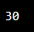
Python JSON
Convert from JSON to Python
import json # some JSON: x = '{ "name":"John", "age":30, "city":"New York"}' # parse x: y = json.loads(x) # the result is a Python dictionary: print(y["age"])

Slide 27
Python JSON
Convert from JSON string to Python
import json # some JSON: x = '{ "name":"John", "age":30, "city":"New York"}' # parse x: y = json.loads(x) # the result is a Python dictionary: print(y["age"])

Slide 28
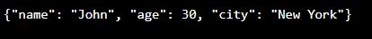
Python JSON
Convert from Python to JSON string
x = { "name": "John", "age": 30, "city": "New York" } # convert into JSON: y = json.dumps(x) print(y)

Slide 29
Python JSON
Convert from Python to JSON string
x = { "name": "John", "age": 30, "married": True, "divorced": False, "children": ("Ann","Billy"), "pets": None, "cars": [ {"model": "BMW 230", "mpg": 27.5}, {"model": "Ford Edge", "mpg": 24.1} ] } print(json.dumps(x))

Slide 30
Python JSON
Convert from Python to JSON string

Slide 31
Python JSON
JSON in ACTS 3.0
In Device variable file:
{
"$first_etherwan_btn": "Network_Broadband_Broad_Edit3",
"$second_etherwan_btn": "Network_Broadband_Broad_Edit4,
}
In Test Scripts Module:
class Web_Setup_ETHER_WAN(Web_Setup_WAN):
def __init__(self, lineNum=''):
self.wan_type = "ETHERWAN"
self.wan_btn = { "1": VAR("$first_etherwan_btn"),
"2": VAR("$second_etherwan_btn"),
"First": VAR("$first_etherwan_btn"),
"Second": VAR("$second_etherwan_btn")
}

Slide 32
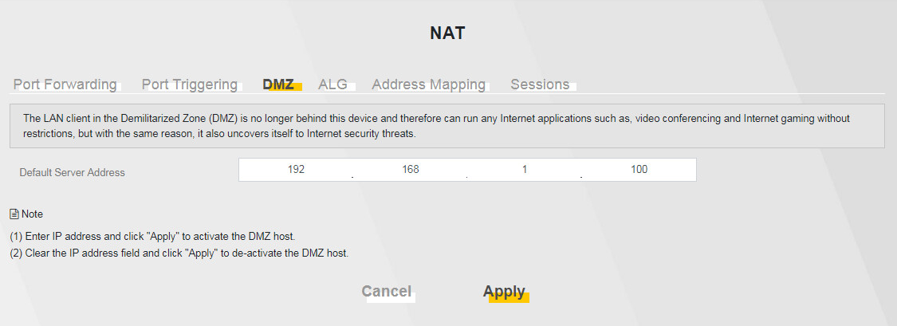
Exercise
給一個 string, server_addr, 例如
server_addr = “192.168.1.100”
請寫一個 program, 可以檢查此 string 是否是一個正確的 IPv4 address，然後將 4 個 numbers 放在 4 個變數中。
a
b
c
d
192
168
1
100
192.168.1.100
server_address

Slide 33
Exercise
給一個 string, 內容為
nas10_0 Link encap:Ethernet HWaddr EC:3E:B3:72:2A:C3
inet addr:172.202.77.82 Bcast:172.202.77.255 Mask:255.255.255.0
inet6 addr: 2001:b021:2d:206:ee3e:b3ff:fe72:2ac3/64 Scope:Global
inet6 addr: 2001:b021:2d:205:ee3e:b3ff:fe72:2ac3/64 Scope:Global
inet6 addr: 2001:b021:2d:207:ee3e:b3ff:fe72:2ac3/64 Scope:Global
inet6 addr: 2001:b021:2d:202:ee3e:b3ff:fe72:2ac3/64 Scope:Global
inet6 addr: fe80::ee3e:b3ff:fe72:2ac3/64 Scope:Link
UP BROADCAST RUNNING PROMISC MULTICAST MTU:1500 Metric:1
RX packets:2540356 errors:0 dropped:0 overruns:0 frame:0
TX packets:376143 errors:0 dropped:0 overruns:0 carrier:0
collisions:0 txqueuelen:1000
RX bytes:295576820 (281.8 MiB) TX bytes:49362314 (47.0 MiB)
請寫一個程式，從這個 string 中，取出 IPv4 address and subnet mask，然後印出 172.202.77.82/255.255.255.0

